Slide 1
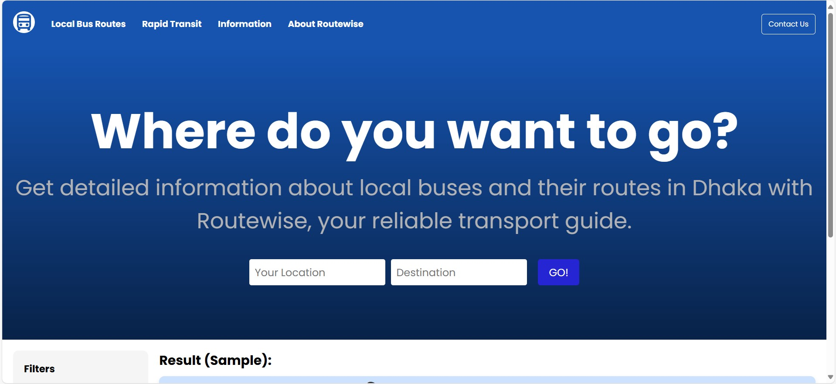
Routewise
A Dhaka Intracity Travel Assistance Platform

Slide 2






Navigating Dhaka’s Public Transport can get Challenging.
Routewise is here for
New Commuters
Transit Enthusiasts
Foreign Visitors
You

Slide 3
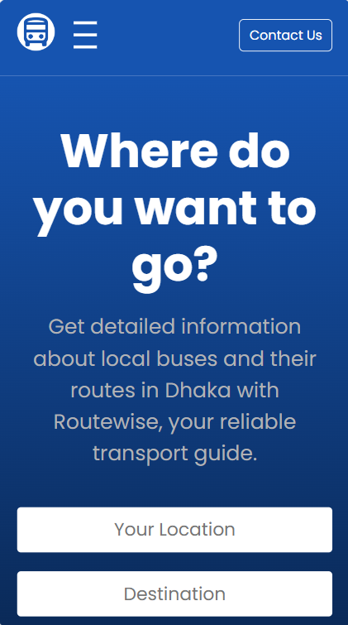
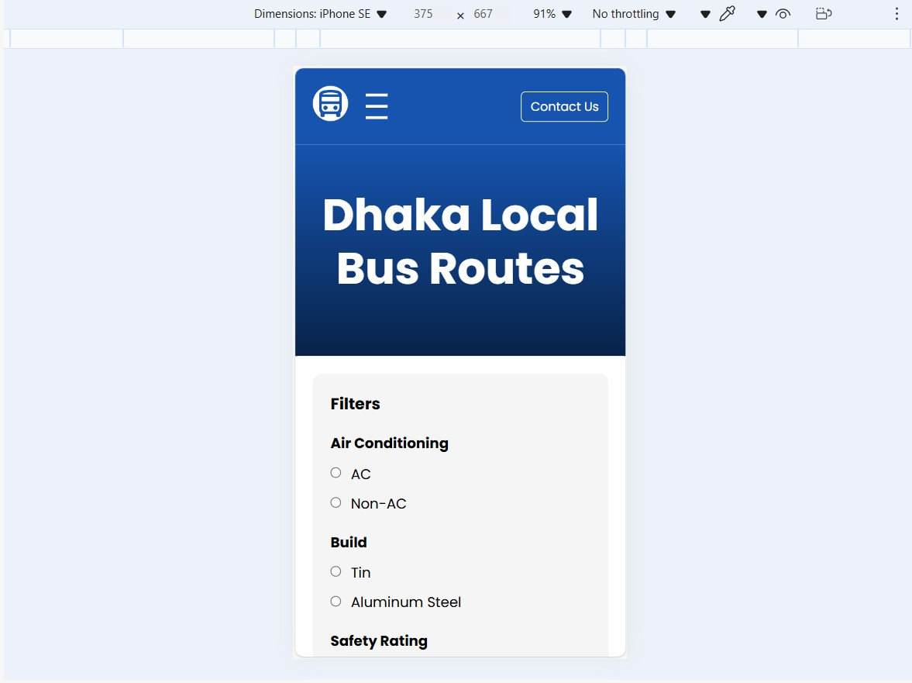
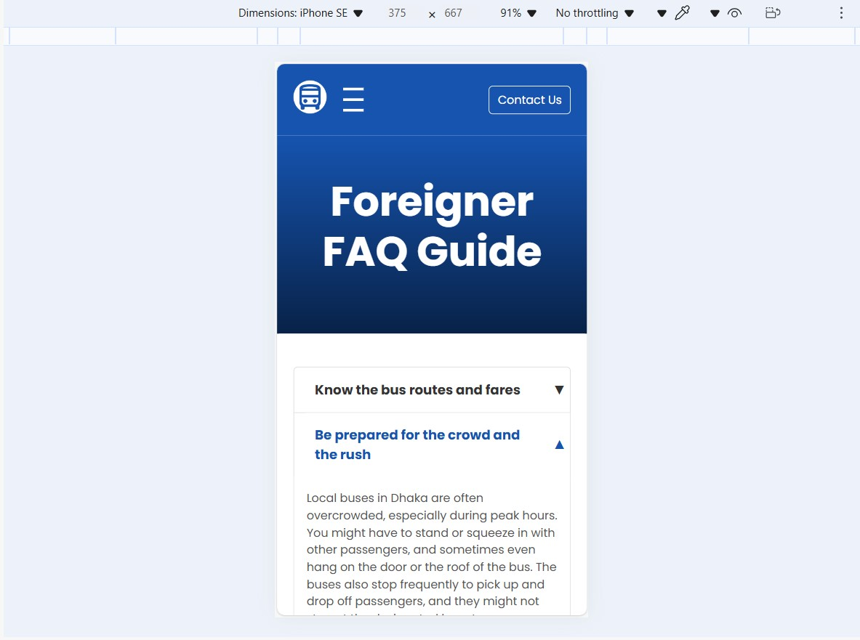
Core Features
1
Bus Route Search
Find and filter buses on relevant routes on origin and destination.
2
Bus Pass Management
Avail and enjoy the convenience and economic benefits of a bus pass.
3
Information and Guides
Interactive map, foreigner guide, FAQs, and safety tips.

Slide 4



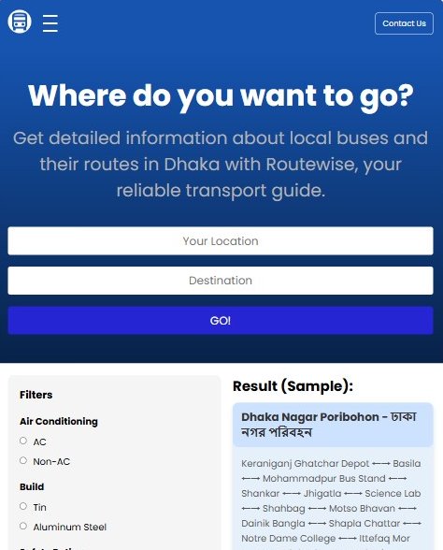

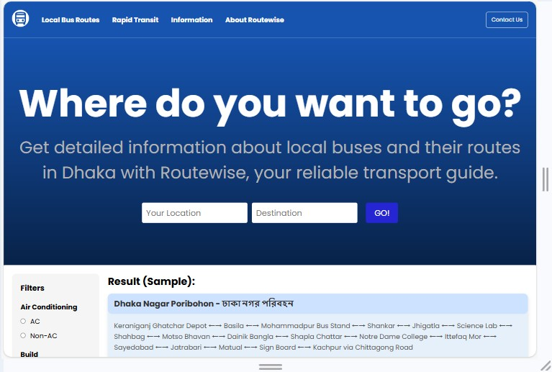
User-Friendly Design
Responsive
Intuitive
Interactive
Optimized for various devices and screen sizes.
Easy navigation for commuters and tourists alike.
Maps and guides for enhanced user experience.

Slide 5
Response Time
1-3 seconds
Lets Get Technical
Internet Load
Lightweight
Availability
99.9% uptime
Our targets
Data Accuracy
Emergency Info
Ensure reliable and up-to-date transit information.
Provide easily accessible safety tips and contacts.
Data Protection
We got your back
Safe transfer of user data and secure API access.

Slide 6
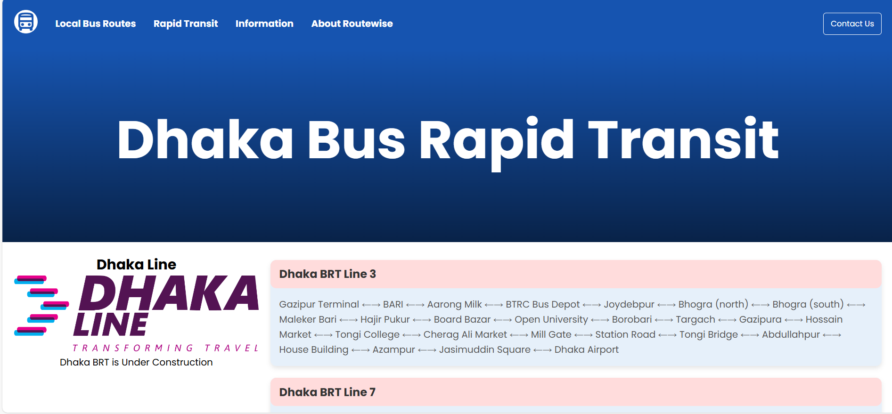
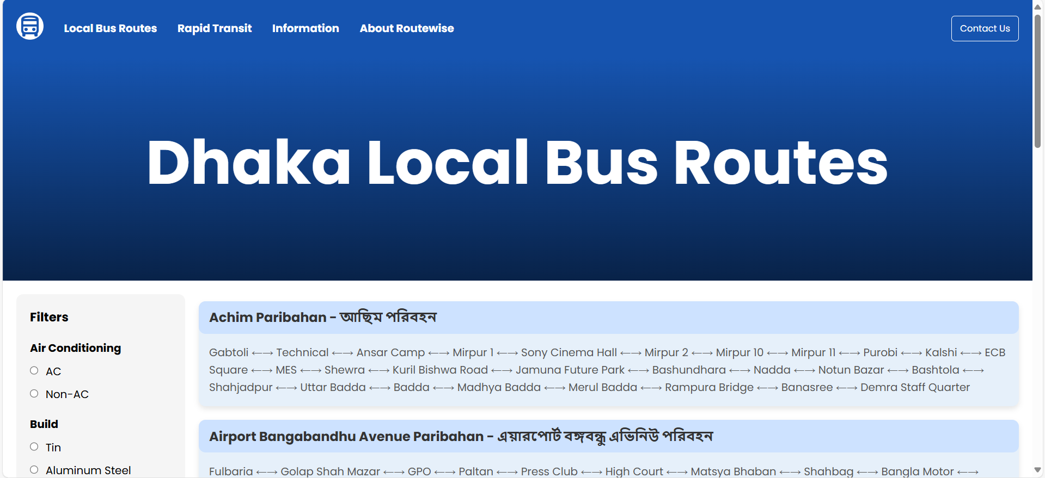
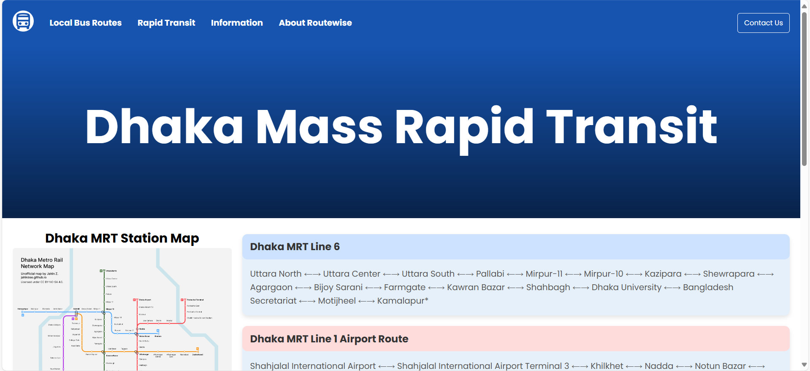
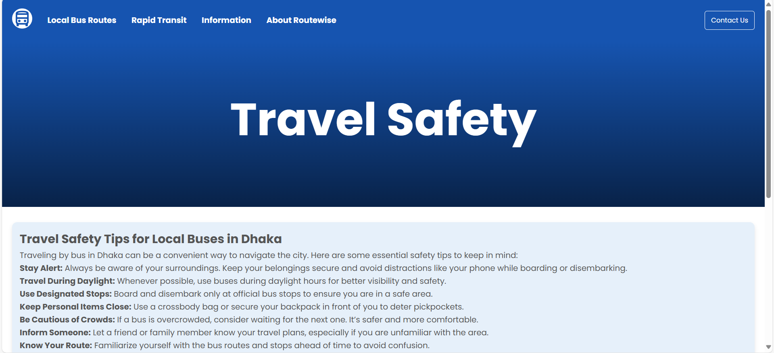
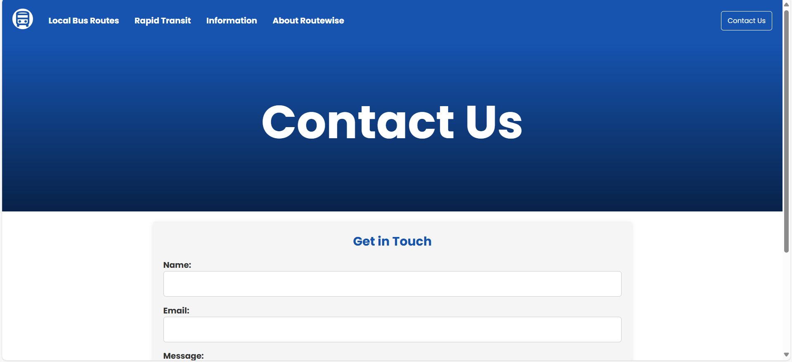
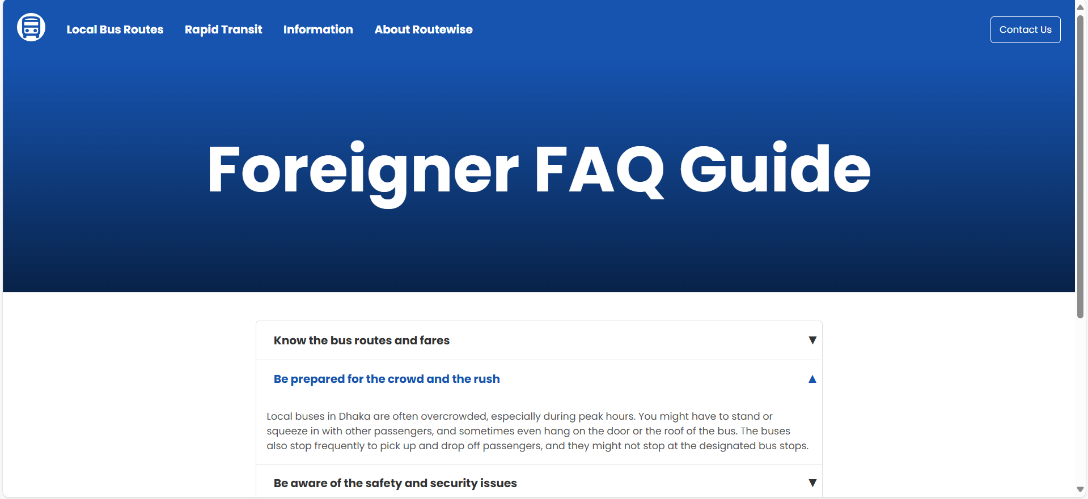
Some Pages

Slide 7

Routewise
Thank you
Zayan Zaman 2110540

